Slide 1
ANATOMY OF THE SPINE

Slide 2
It is composed of 33 bones called vertebrae which are separated by intervertebral discs.Divided into sections:the cervical,thoracic,lumbar,sacrum and coccyx bones
The vertebral column has 4 main functions:
1)Protection-encloses and protects the spinal cord within the canal
2)support-carries weight of body above pelvis
3)Forms the central axis of the body
4)Role in movement and posture
Structure of vertebrae
Each consist of an anterior vertebral body and posterior vertebral arch
Vertebral body-forms the anterior part of each vertebrae.
It’s the weight bearing component.Those in the lower portion have larger bodies than those in the upper portion(support the increasing weight)

Slide 3
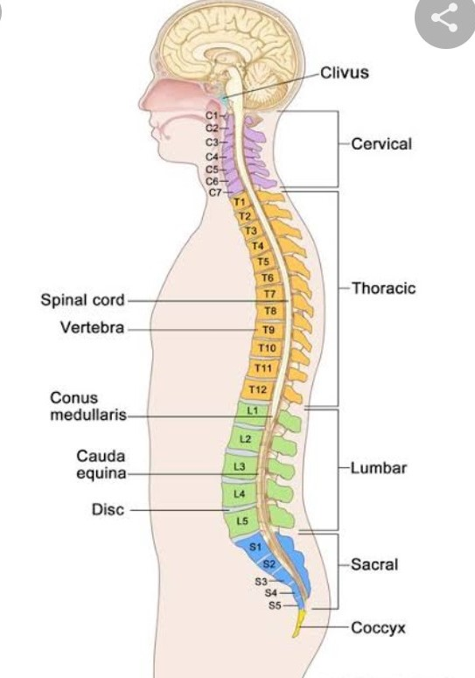
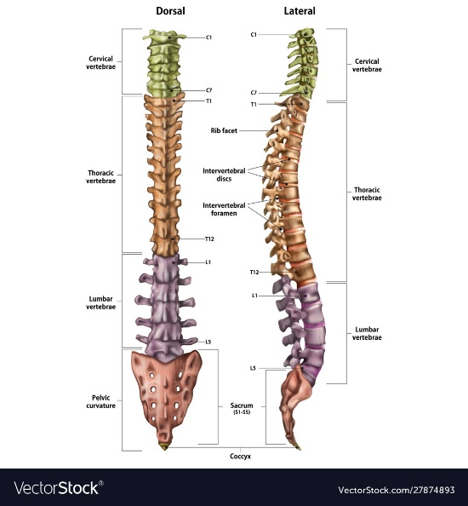

Slide 4
The superior and inferior aspects of the body are lined with hyaline cartilage.
Vertebral arch-forms the lateral and posterior aspect of each vertebrae
The arch in combination with the vertebral body form an enclosed hole which is the vertebral foramen.The foramina of all vertebrae line up to form vertebral canal that encloses the spinal cord.
The arches have several bony prominences that act as attachment sites for muscles and ligaments
i)Spinous processes-each vertebra has a single spinous process,centred posteriorly at the point of the arch
ii)Transverse processes-each has 2 that extend laterally and posteriorly from the vertebral body

Slide 5
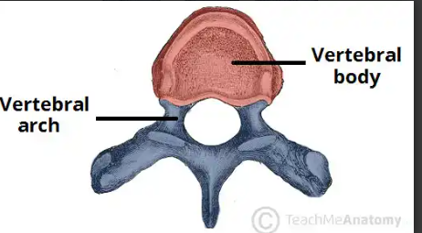
iii)pedicles-connect vertebral body to the transverse process
Iv)lamina-connects the transverse and spinous processes
V)Articular processes-form joints between one vertebra and its superior and inferior counterparts

Slide 6
Classification of vertebrae
Cervical vertebrae
There are seven in number C1-C7 and is connected to the base of the skull
The top two are known as atlas and axis respectively and they form the joint that connects the skull to the spine
The cervical portion is responsible for mobility and normal functioning of the neck as well as protection of the spinal cord , arteries and nerves that travel from the brain to the rest of the body

Slide 7
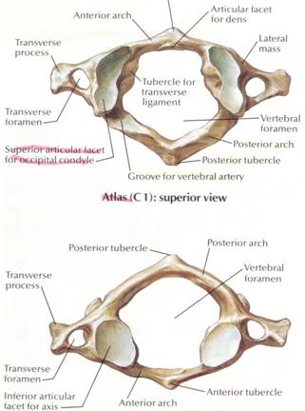
C1-atlas
No body
2 articular pillars
Vertebral foramen and a flat articular
Surface
Anterior and posterior arches
Important anatomical points
i)Groove for vertebral artery –common
Fracture site
ii)Superior articular process-flex/extension
iii)Inferior art process allows rotation

Slide 8
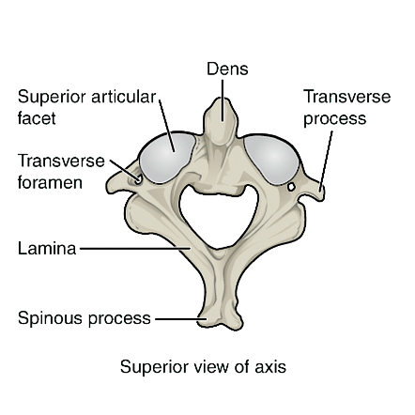
C2-Axis
Dens-is an embryological derivative of c1
Its poorly vascularized
Prone to osteoporosis
The dens articulates with anterior arch of atlas creating
Medial atlantoaxial joint
The axis also contains superior articular facets which
Articulates with the inferior articular facets of the atlas to
Form the two lateral atlantoaxial joints

Slide 9
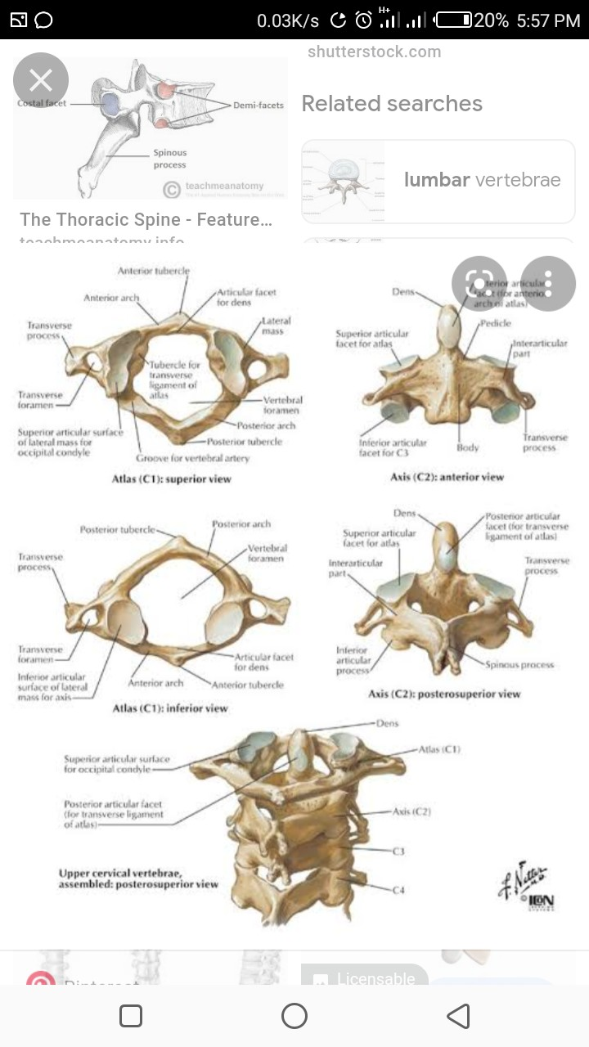

Slide 10
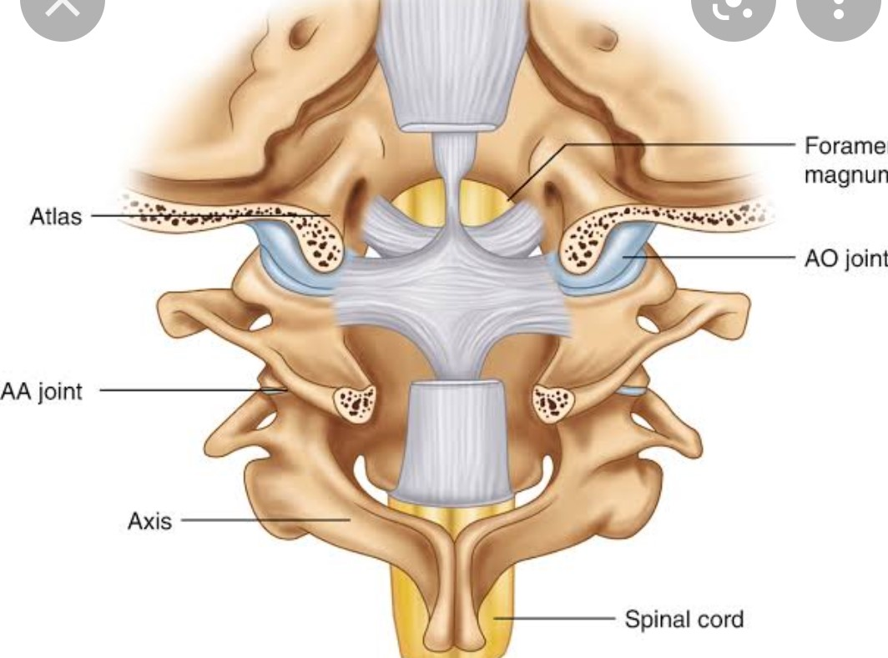
Atlantoaxial anatomy
Articulation of the atlas and axis forms
Forms the atlantoaxial joint
2 lateral and medial

Slide 11
The median atlantoaxial joint is formed between the dens of the axis and an osteoligamentous ring of the atlas anteriorly and transverse ligament posteriorly.Its classified as a pivot
The lateral atlantoaxial joint are bilateral joints formed between the lateral masses of the atlas and axis.classified as gliding or plane joints
ligaments
Cruciform ligament-is a complex of 3 ligaments-one horizontal and two longitudinal
The 3 bands are transverse that runs transversely between the lateral masses of the atlas and arches behind the dens

Slide 12
The transverse lig is the main stabilizer of the dens of axis ,acting to resist forward translation of the atlas relative to the axis
Superior longitudinal band of cruciform- arises from the superior margin of the median part of the transverse ligament.
lies between the apical ligament of the dens and the tectorial membrane
Inferior longitudinal band-arises from the inferior margin of the median part of the transverse lig

Slide 13
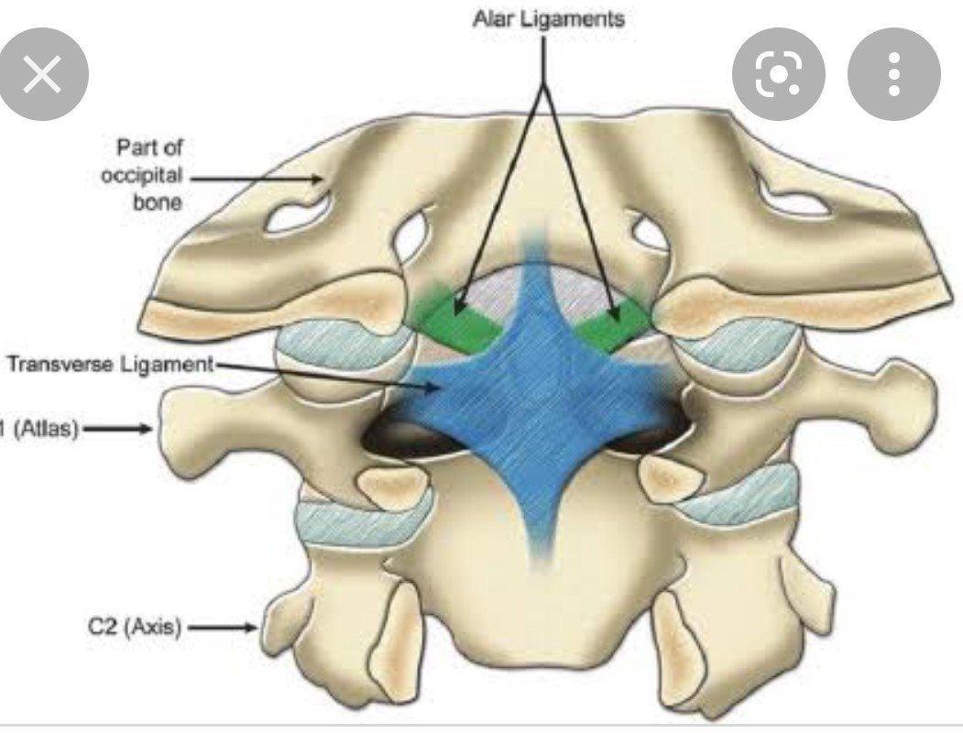

Slide 14
Accessory ligaments
Tectorial membrane-represents the superior continuation of the posterior longitudinal ligament.It is situated posterior to the cruciform and alar ligaments
Alar ligaments-short but strong and act to limit excessive motion within the atlantoaxial joint
Apical ligament of dens-originates from the apex of dens fanning out superiorly to attach to anterior margin of foramen magnum
Anterior atlantoaxial membrane-continuation of anterior longitudinal and spans the length from inferior border of atlas to inferior part of axis
Posterior atlantoaxial membrane-continuation of ligamentum flavum

Slide 15
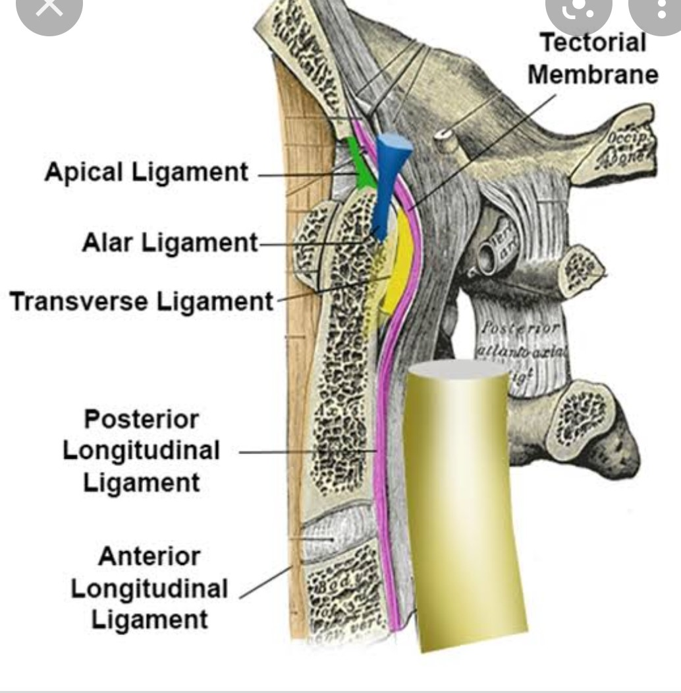

Slide 16
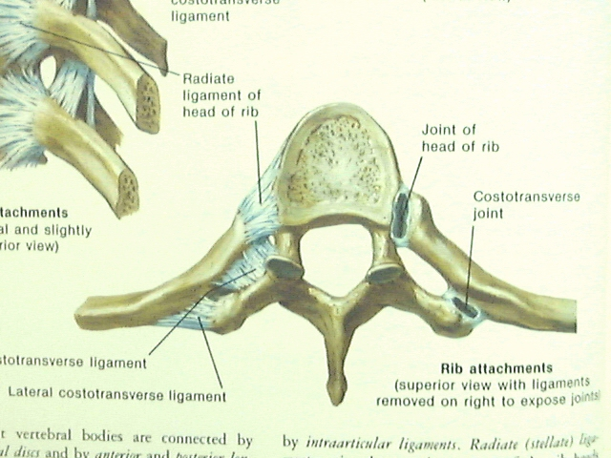
Thoracic vertebrae
Are twelve in number.They are medium sized and increase in size from superior to inferior .
They articulate with ribs producing the bony thorax
Has a narrow spinal canal
On the transverse processes ,theres a costal facet for
Articulation with the shaft of a single rib
Spinous process is oriented obliquely inferiorly and
Posteriorly
In contrast to the cervical vertebrae,the vertebral foramen
Of thoracic vertebrae is circular

Slide 17
Lumbar vertebrae
Are 5 in number.They are the largest in the vertebral column.Lordosis is a natural allignment
Structurally modified to support the weight of the torso
They are kidney shaped,no transverse foramen,costal facets or bifid spinous processes
Similar to cervical vertebrae in that it has a triangular shaped vertebral foramen
Spinous processes are shorter than those of thoracic and do not extend inferiorly below the level of vertebral body
Their size and orientation permits needle access to their spinal canal and spinal cord during lumbar puncture or epidural anaesthesia

Slide 18
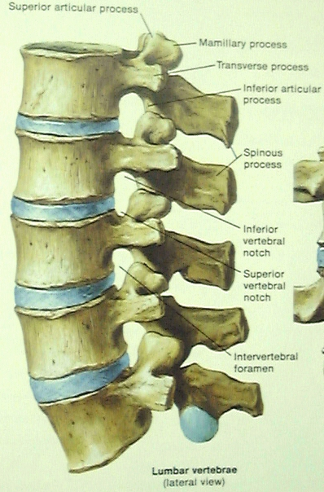
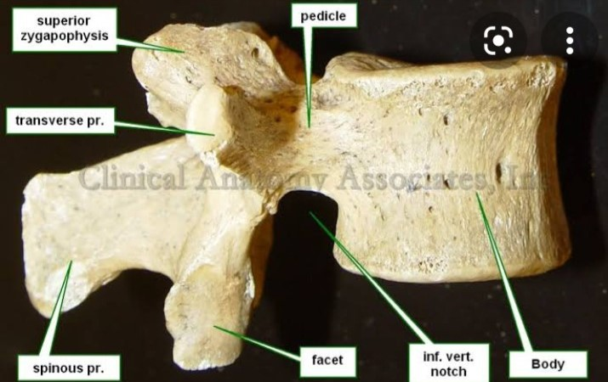

Slide 19
Sacrum and coccyx
Sacrum is a collection of five fused vertebrae
It looks like an inverted triangle with the apex pointing inferiorly
On the lateral walls of the sacrum are facets for articulation with the pelvis at the sacroiliac joints
Coccyx is a small bone which articulates with the apex of the sacrum.It lacks vertebral arches thus has no vertebral canal
Separation of S1 from the sacrum is known as lumbarization while fusion of L5 to the sacrum is sacralisation.These are congenital anomalies

Slide 20
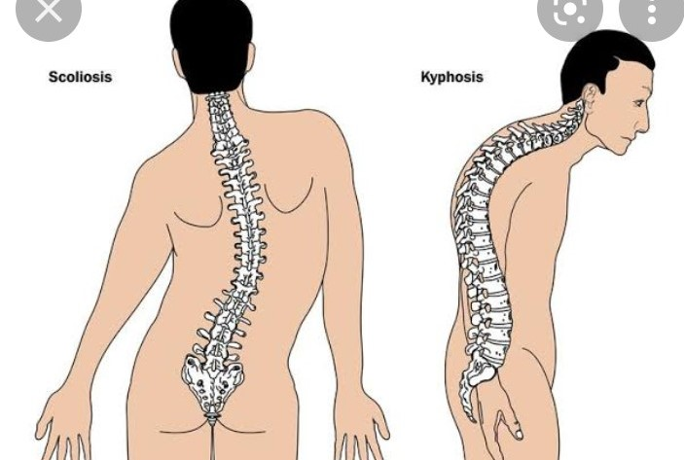

Slide 21
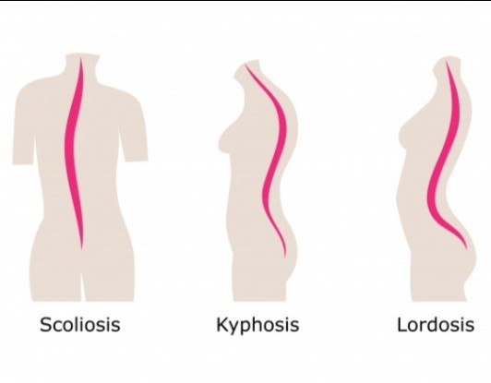

Slide 22
Joints and ligaments
The mobile vertebrae articulate with each other via joints between their bodies and articular facets:
Left and right superior articular facets articulate with vertebra above while the inferior facets articulate with vertebra below
The vertebral bodies indirectly articulate with each other via intervertebral discs
Vertebral body joints are cartilaginous joints designed for bearing weight.The articular surfaces are covered by hyaline cartilage and are connected by intervertebral disc
2 ligaments strengthen the vertebral body joints:the anterior and posterior longitudinal ligaments

Slide 23
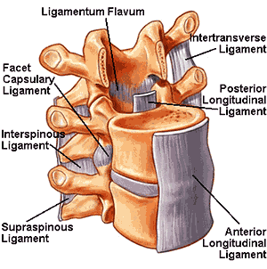
The anterior longitudinal ligament is thick and prevents hyperextension of the vertebral column The posterior longitudinal ligament is weaker and prevents hyperflexion The joints between articular facets called facet joints allow for some gliding motions between the vertebrae -ligamentum flavum-exends between lamina of adjacent vertebrae -interspinous and supraspinous-join the spinous processes of adjacent vertebrae interspinous ligaments attach between processes and the supraspinous ligaments attach to tips Intertransverse ligaments-extends between transverse process

Slide 24
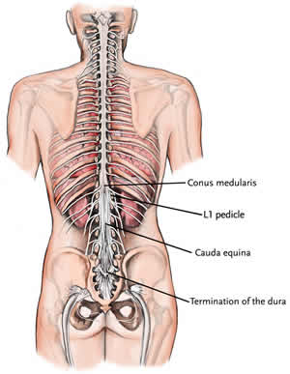
Spinal cord
It’s a tubular bundle of nervous tissue and supporting cells extending from the foramen magnum to the lumbar vertebrae(L1-L2)
It travels inferiorly within the vertebral canal
Its surrounded by spinal meninges containing
Cerebrospinal fluids
At L2 the cord tapers off forming the conus
Medullaris

Slide 25
The spinal nerves that arise from the end of the spinal cord are bundled together forming cauda equina. Compression of cauda equina leads to cauda equina syndrome.
2 enlargements :cervical enlargement located C4-T1 level and is the origin of brachial plexus
lumbar enlargement between representing the origin of the lumbar and sacral plexus(T11-l1)
The enlargements accommodate the greater number of nerve cells and connections needed to process information related to upper and lower limbs
The enlargement that corresponds to the arms is the cervical whereas lumbar corresponds to the legs

Slide 26
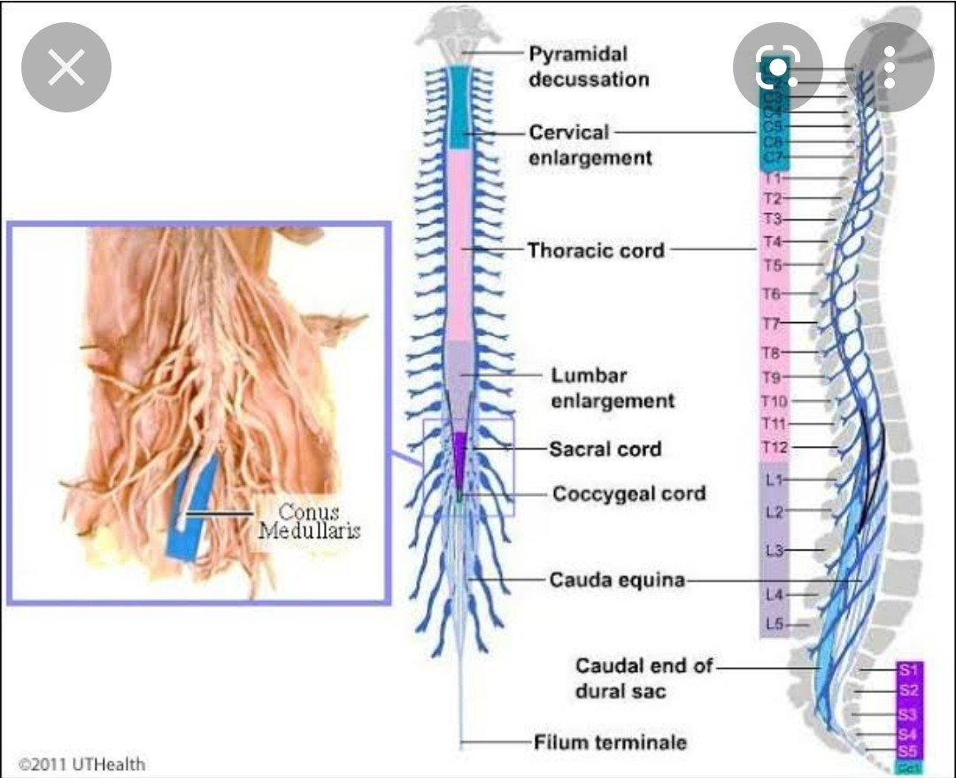
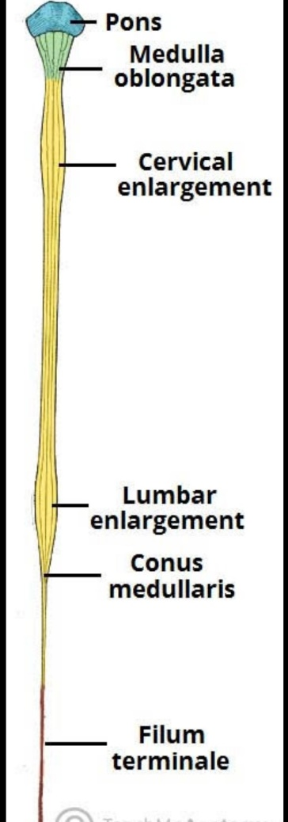

Slide 27
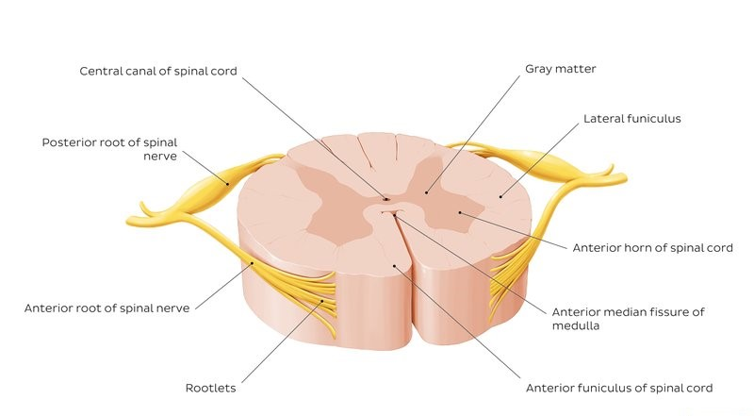
The spinal cord has a fissure located anteriorly and sulci located anterolateral,posterolateral and posterior

Slide 28
The anterolateral sulcus denotes the location at which ventral fibres leave the spinal cord.
The gray matter is the butterfly shapedcentral part of the spinal cord and is comprised of neuronal cell bodies.carries postganglionic nerve fibres from the paravertebral ganglia in the sympathetic chain to the target organ
Shows anterior ,lateral and posterior horns
White matter surrounds gray matter and is made of axons .contains pathways that connect the brain with the rest of the body

Slide 29
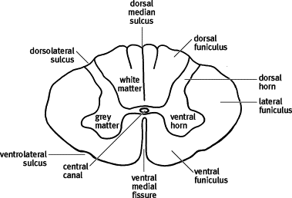

Slide 30
Blood supply of the spinal cord
Main blood supply is via single anterior spinal artery and two posterior spinal arteries
Anterior spinal is formed by vertebral arteries that originate from first part of subclavian artery.Before joining to become basilar artery,the vertebral arteries each give off a branch which becomes the anterior spinal artery and travels caudaly through the anterior sulcus
Posterior spinal branch off posterior inferior cerebellar artery
Segmental spinal arteries are additional arteries that bifurcate into anterior and posterior radicular artery.supply nerve roots along which they track
Lower cervical to upper thoracic spinal cord is supplied by radiculomedullary arteries arising fromcervicothoracic trunk

Slide 31
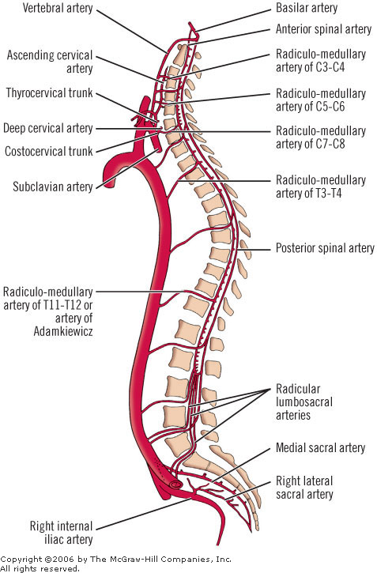

Slide 32
spinal nerves
Part of the peripheral nervous system.it is a mixed nerve carrying motor ,sensory and autonomic signals between the spinal cord and the body
There are 31 in number and roughly correspond to a segment of the vertebral column .8 Cervical(c1-c8),thoracic( T1-T12),5 lumbar(l1-l5)
5 sacral(s1-s2)
Near the spinal cord each spinal nerve branches into two roots,dorsal and ventral . sensory fibres entering the spinal cord via the dorsal root:its cell bodies lie in a spinal ganglion that is outside the spinal cord via the central root
Motor fibres leave the cord via ventral root,its cell bodies lie in specific areas of the spinal cord itself

Slide 33
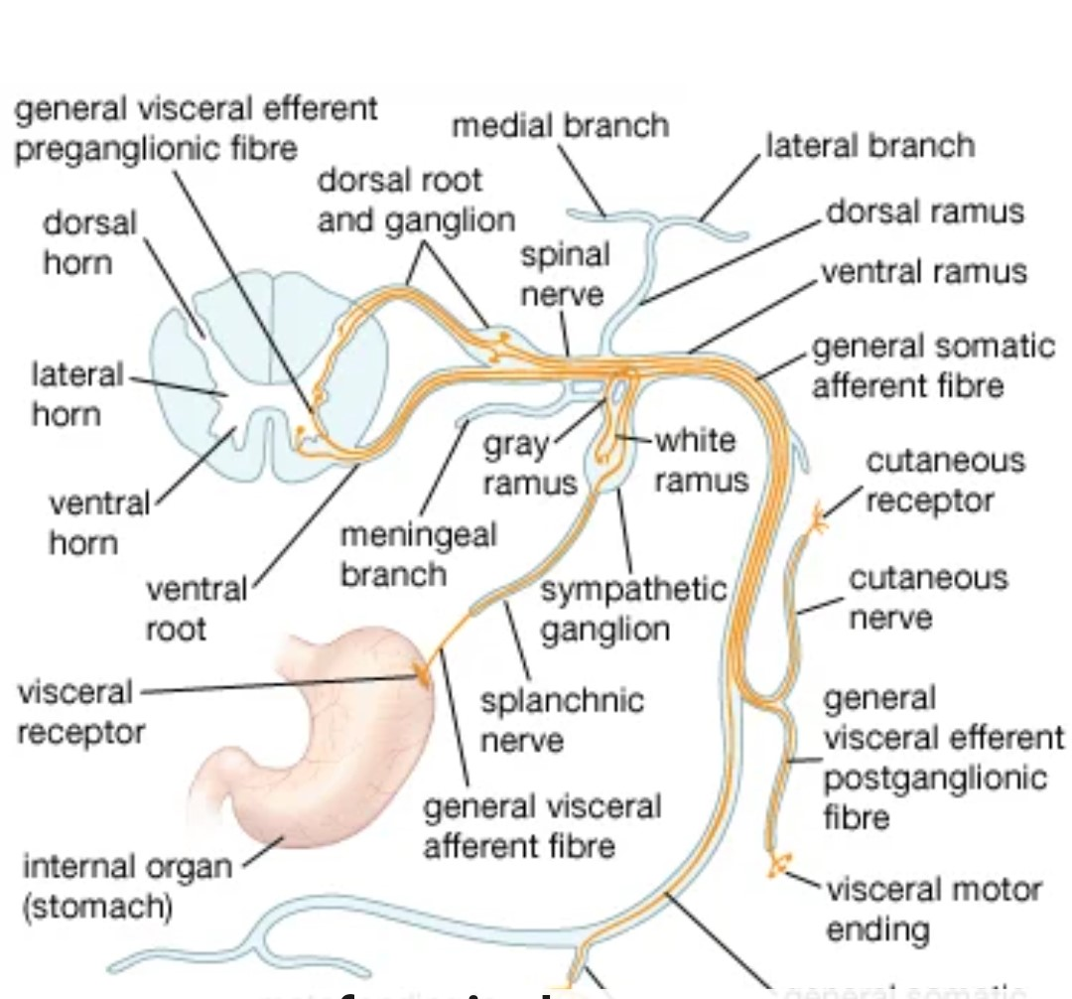

Slide 34
The anterior/ventral ramus innervatesthe skinand muscle on the anterior aspect of the trunk while posterior /dorsal ramus innervates the post-vertebral muscles and skin of the back.
Nerve fibres supplying the upper limb are from anterior rami which have been redistributed within a network of nerves(nerve plexus)
The anterior rami of the upper cervical spinal nerves form cervical plexus(supplies anterior neck)
Lower cervical and first thoracic anterior rami form the brachial plexus(supplies upper limb)
Lower lumbar and upper sacral anterior rami form the lumbosacral plexus (supplies lower limb)
The thoracic anterior rami remain segmental becoming the intercostal nerves

Slide 35
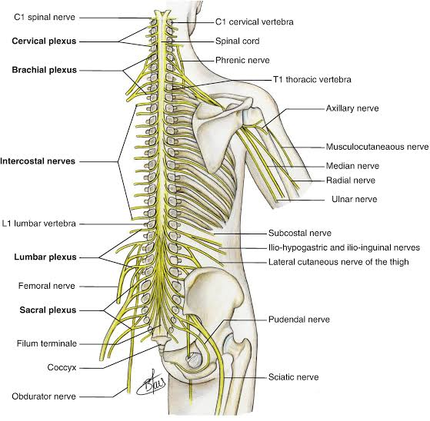

Slide 36
The spinal nerve also gives off a meningeal(sinuvertebral)branch which provides sensory and vasomotor innervation to the spinal meninges
Types of fibers
Somatic efferent-responsible for motor innervation of skeletal muscles
Somatic afferent-carry sensory information from the skin,joints and muscles to the posterior/dorsal column
Visceral efferent-autonomic fibres that supply the organ.Divided into sympathetic and parasympathetic
Sympathetic origin-fromthoracic as well as L1&L2
Parasympathetic-originate from S2-S4 to supply pelvic and lower abdominal viscera
Visceral afferent-innervate organs

Slide 37
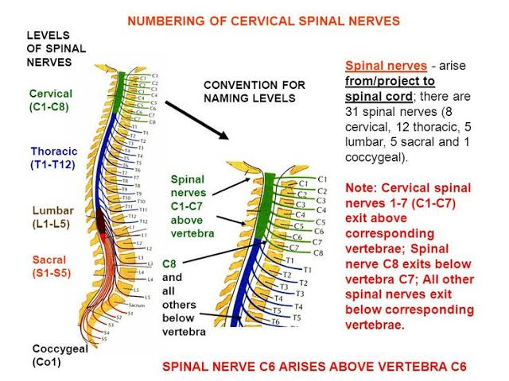

Slide 38
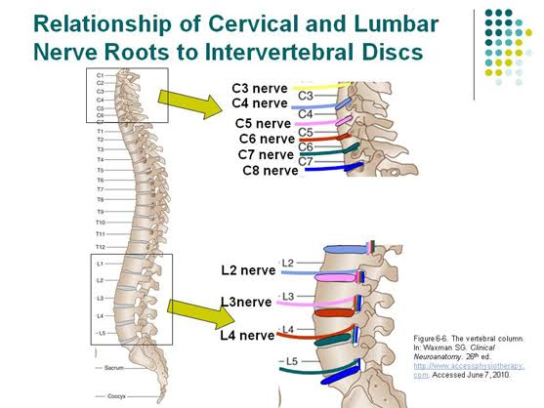

Slide 39
Dermatomes
They are defined as area of skin to which the sensory component of a spinal nerve is distributed to a specific spinal cord segment.
All dermatomes below the shoulder relay their sensory information back to the CNS through spinal nerves.

Slide 40
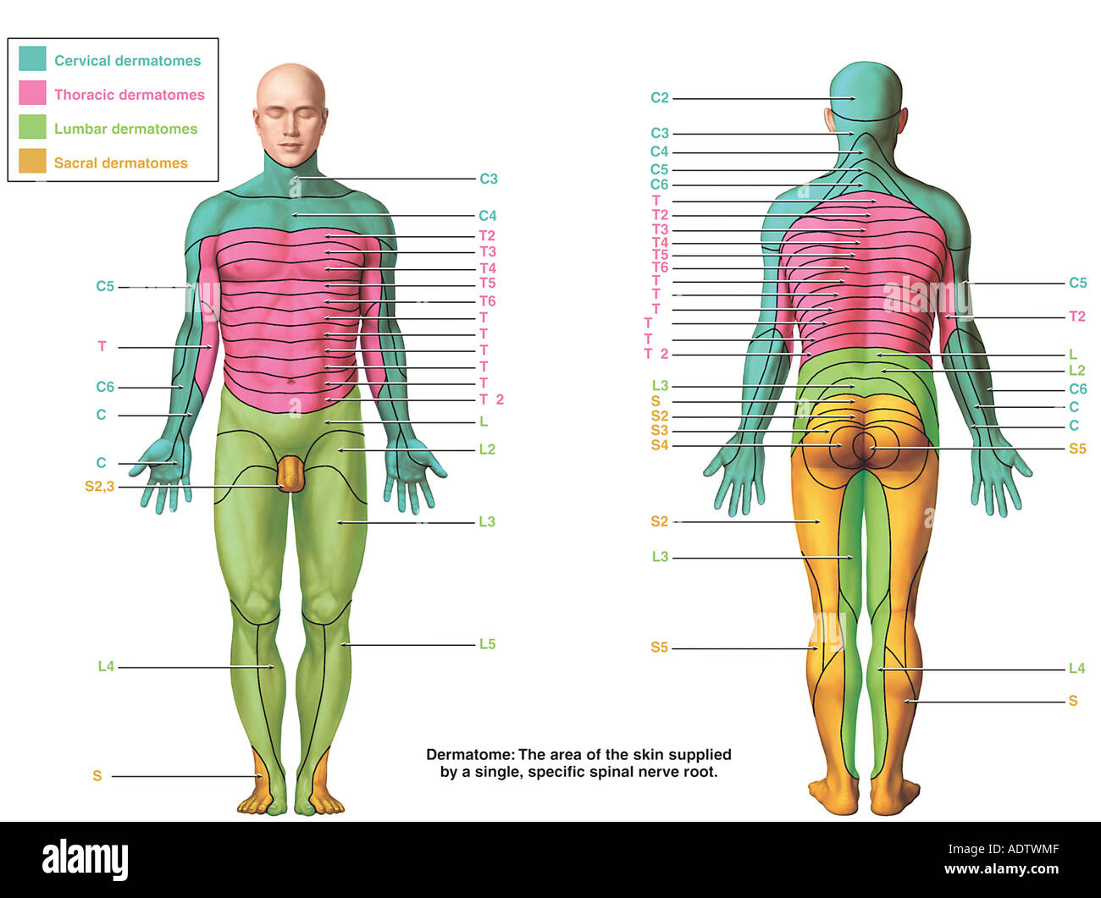

Slide 41
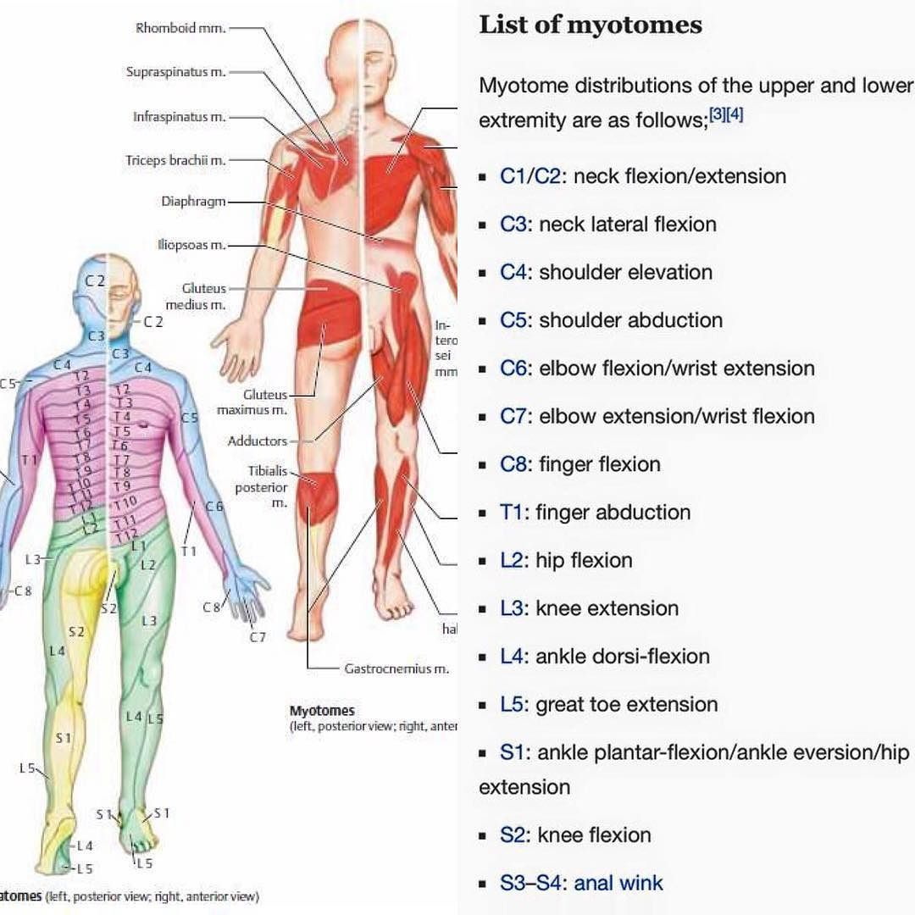
Myotomes-these are muscles served by a spinal nerve

Slide 42
Spinal meninges
There are 3 membranes that surround the spinal cord-the dura ,arachnoid and pia matter
Distally,the meninges form a strand of fibrous tissue-the filum terminale which attaches to vertebral bodies of the coccyx.
Dura matter
Is the most external of the meninges
Separated from the walls of vertebral canal by the epidural space that contains some loose connective tissue and the internal vertebral venous plexus

Slide 43
Arachnoid matter
Its located between dura matter and the pia matter
Its separated from the latter by the subarachnoid space containing cerebrospinal fluid
Distal to the conus medullaris ,subarachnoid space expands forming the lumbar cistern.This space accessed during a lumbar puncture
Pia matter
Innermost of the meninges
It is a thin membrane that covers roots and their blood vessels .Inferiorly ,the spinal pia mater fuses with the filum terminale
The arterial supply of the spinal cord-anterior and posterior spinal arteries
Additional arterial supply is via the anterior and posterior segmental medullary arteries.

Slide 44
Spinal tracts
White tracts send messages to and from the brain
Ascending and descending tracts
Ascending carry impulses into the brain i.etouch,deep vibration,position
Descending tracts carry impulses necessary for voluntary muscle mvt
The spinal cord is not only a conduit but it also modifies and intergrates the information passing through
Ascending tracts-pathway consists of neurons
1st order-detect stimulus and transmit it to the spinal cord
2nd order-carry signal up the spinal cord to the brain
3rd order-carry signal to the sensory region of the cerebral cortex

Slide 45
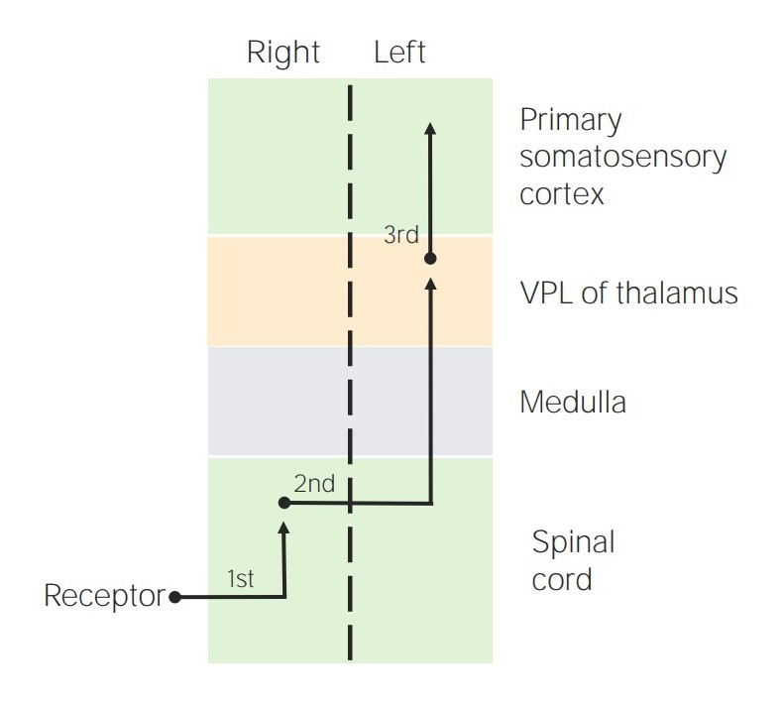
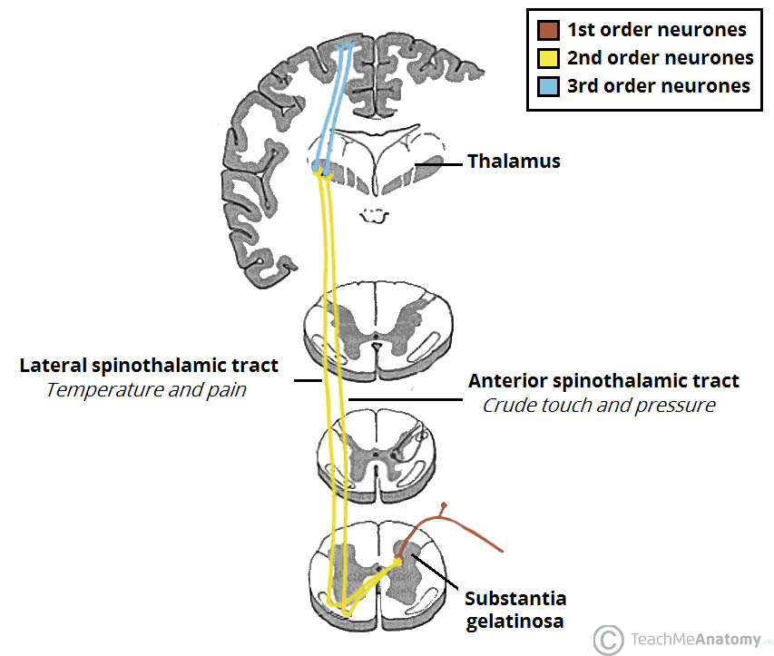
Spinothalamic –transmit sensations of pain ,temperature,gross touch and pressure

Slide 46
Spinocerebellar tract
Has dorsal and ventral components.Dorsal fibers do not decussate whereas ventral decussate upon entering the spinal cord and in the brainstem.All fibers end in the ipsilateral cerebellum
Transmits proprioception
Descending
Carries motor and visceral impulses down the cord.
Pathway consists of 2 types of neurons-upper and lower motor
Corticospinal-has lateral and ventral/anterior components
Lateral tract decussates in the medulla whereas ventral decussates just before exiting the spinal cord

Slide 47
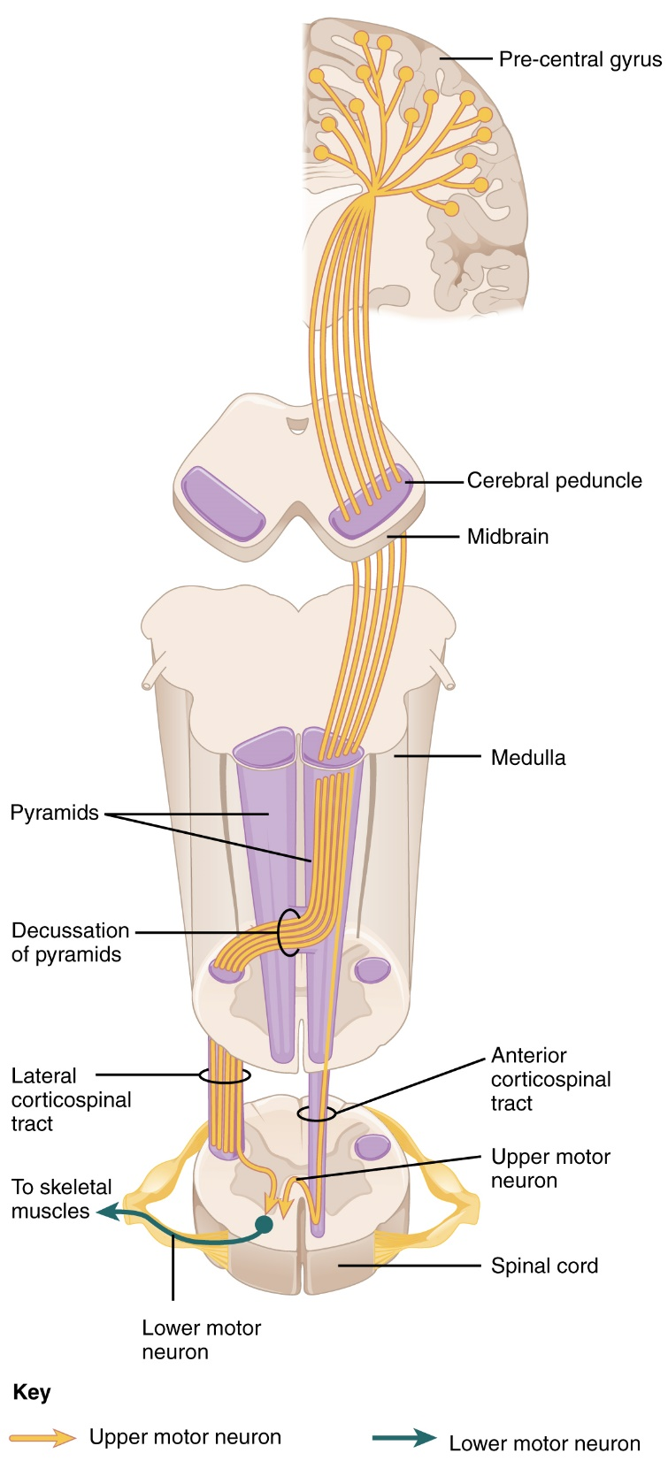
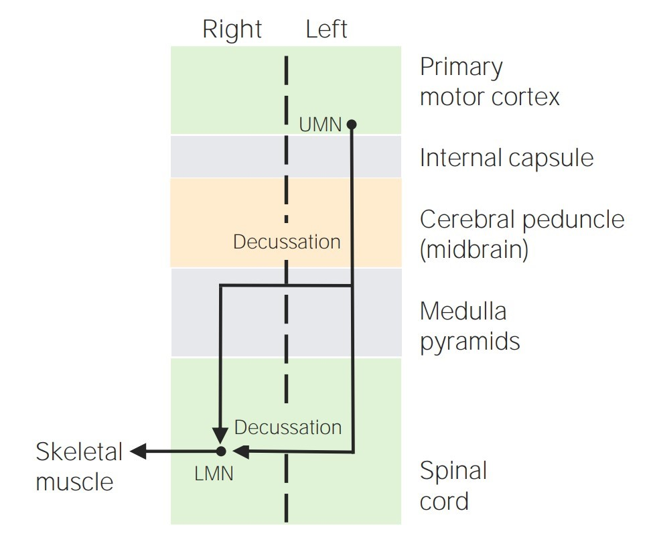

Slide 48
EXAMINATION OF THE SPINE
Can be broken down to four key components:look,feel,move and special tests
Look
General inspection for clinical signs underlying pathology such as body habitus,scars that may indicate previous spinal surgery,wasting of muscles.
Closer inspection of the spine-Ask patient to stand and turn in 90 degree increments as you inspect the spine from each angle for evidence of pathology
Anterior inspection-check for scars ,posture –note any asymmetry which may indicate joint pathology or scoliosis,asymmetry of the shoulder girdle that may be caused by scoliosis fractures or disloactions

Slide 49
Pelvic tilt-lateral pelvic tilt can be caused by scoliosis,leg length discrepancy or hip abductor weakness
Lateral inspection
Note abnormalities such as
cervical lordosis-hyperlordosis is associated with chronic degenerative joint disease i.e osteoarthritis
Thoracic kyphosis
Lumbar lordosis-loss of normal lumbar lordosis is associated with sacroiliac joint disease such as ankylosing spondylitis
Posterior inspection
Inspect patient from behind

Slide 50
Spinal alignment-inspect for lateral curvature of the spine indicative of scoliosis
Iliac crest alignment-misalignment may indicate leg length discrepancy
Muscle wasting
Bruising-may suggest trauma
Gait-ask patient to walk to the end of the examination room and then turn and walk back to you
Check for limping,leg length,turning,Trendelenburg gait,waddling gait

Slide 51
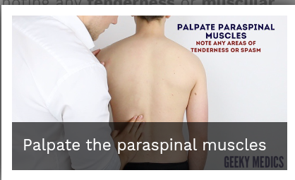
Feel
Palpate the spinal processes and sacroiliac joints assessing their alignment and note any tenderness
Palpate the paraspinal muscles noting muscular spasms or tenderness

Slide 52
Move
Assess active and passive movement
Active mvt-performed by the patient independently.Ask patient to perform a sequence of active mvts to assess joint function i.e bending
Note any restrictions ,signs of discomfort
Passive mvt-move the joints observing discomfort and feel for crepitus
Cervical spine
Flexion-normal range 0-80 degrees.Ask patient to touch their chin to their chest

Slide 53
Extension-ROM 0-50 degrees.Ask patient to look at the ceiling
Lateral flexion-ROM 0-45 Ask patient to touch their ear to their shoulder on each side
Rotation –Ask patient tto turn their head to the left and the right
Lumbar
Flexion-ask patient to touch their toes whilst keeping their legs straight
Extension-ROM 10-20 degrees .
ask patient to lean back as far as they are comfortably able whilst positioned close to them for support if needed
Lateral flexion-ask patient to slide their left hand down the outer aspect of their leg as far as they are able to whilst keeping their legs straight

Slide 54
Thoracic
Rotation-ask patient to sit on side of the clinical examination couch and cross their arms.Then ask them to turn to the left or right as far as they are comfortably able to

Slide 55
Special tests
Schobers test
Used to identify restricted flexion of the lumbar spine that may occur i.e in ankylosing spondylitis
Identify the location of posterior superior iliac spine (psis)on each side
Mark the skin in the midlne 5 cm below the psis
Mark the skin in the midline 10cm above the psis
Ask patient to touch their toes to assess lumbar flexion
Measure distance between the two lines

Slide 56
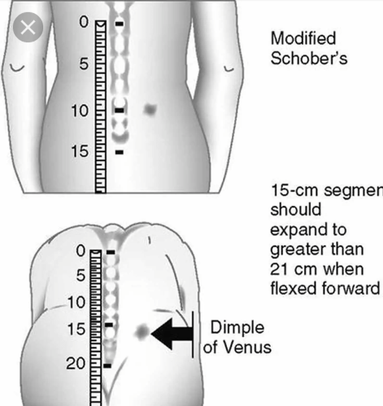

Slide 57
Sciatic stretch test(straight leg raise)
Is used to identify sciatic nerve irritation
Position patient in supine
Hold the patients ankle ,raise their leg by passively flexing the hp while keeping the patients knee fully extended
The normal range of mvt for passive hip flexion is approx. 80-90
Once the patients hip is flexed dorsiflex the patients foot.

Slide 58
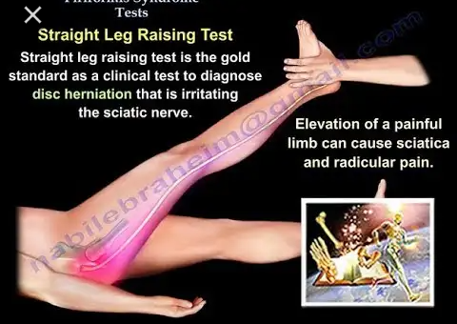

Slide 59
The test is considered posiive I patient experiences pain the posterior thigh or buttock.Nerve irritation may be secondary to lumbar disc prolapse
Femoral nerve stretch
Used to identify femoral nerve irritation
Position patient prone on the exam couch
Flex the patients knee to 90 degreees then extend the hip joint
Finally plantar flex the patients foot

Slide 60
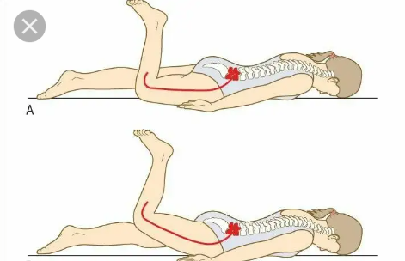

Slide 61
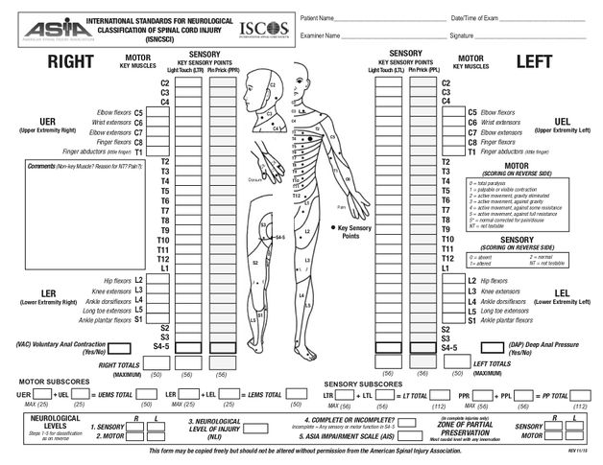
ASIA CHART(American spinal cord injury association)
Involves both motor and sensory examination to determine sensory and motor examination for each side of the body to determine whether injury is complete or incomplete

Slide 62
Key sensory points are located in relation to bony anatomical landmarks in the dermatomes.Teseted by bilaterally using light touch i.e cotton tip applicator and pin prick(sharp dull discrimination).Appreciation of light touch and pin prick sensation is made in comparison to sensation on patients cheek.Rate if its absent,altred or normal
Motor examination-ask patient to perform activity and check for range of mvt acquired i.e hip flexion to see if L2 has a problem

Slide 63
Reference
https://neurosurgicalassociates.com/anatomy of the spine
Apleys system of orthopedics and fractures
https://radiologykey.com/spine anatomy
Teachmeanatomy.info/neck/bones

